Slide 1

بسم اللہالرحمٰن الرحیم
My Lord, put my heart at peace for me,​ and make my task easy for me and remove the knot from my tongue, so that they may understand my speech.​
​​[20:24-28]​

Slide 2
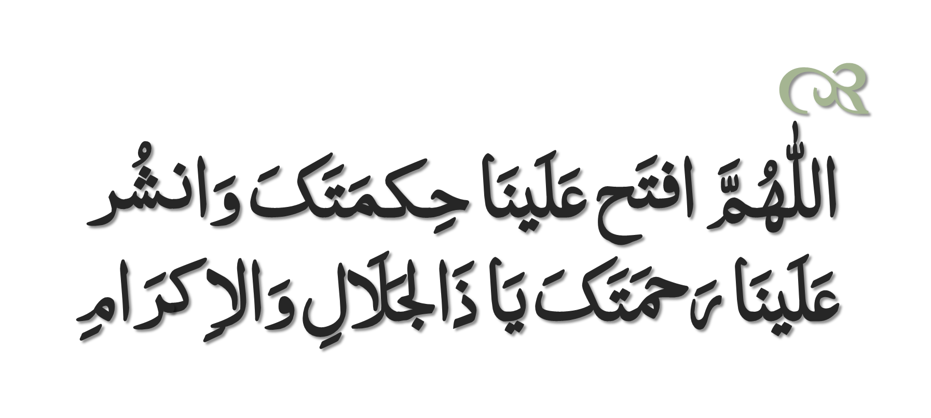
Dua to Recite Before Study

Slide 3
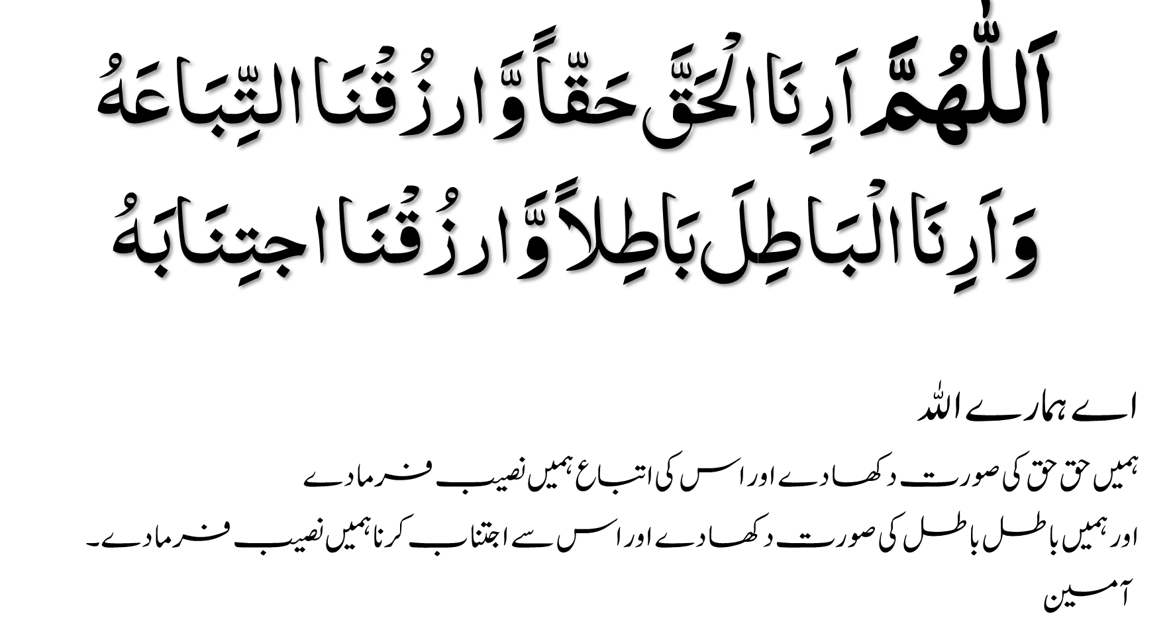

Slide 4
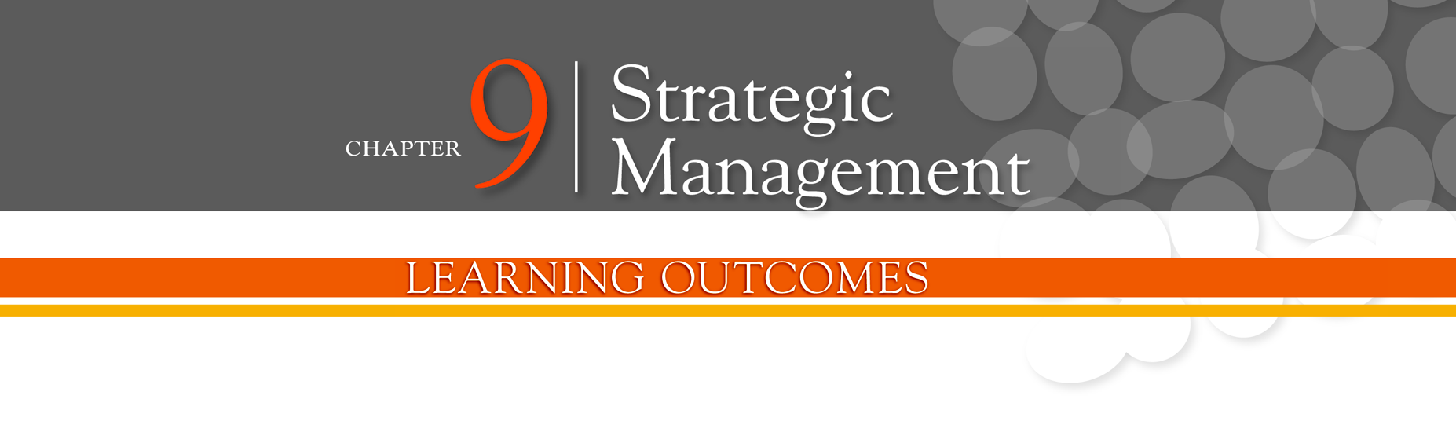
Define strategic management and explain why it’s important
Explain what managers do during the six steps of the strategic management process
Describe the three types of corporate strategies
Describe competitive advantage and the competitive strategies organizations use to get it
Discuss current strategic management issues

Slide 5
What Is Strategic Management?
Strategic management - what managers do to develop the organization’s strategies.
Strategies - the plans for how the organization will do what it’s in business to do, how it will compete successfully, and how it will attract and satisfy its customers in order to achieve its goals.
Business model - how a company is going to make money.

Slide 6
Why Is Strategic Management Important?
It results in higher organizational performance.
It requires that managers examine and adapt to business environment changes.
It coordinates diverse organizational units, helping them focus on organizational goals.

Slide 7
What is the Strategic Management Process?
Strategic management process - a six-step process that encompasses strategic planning, implementation, and evaluation.

Slide 8
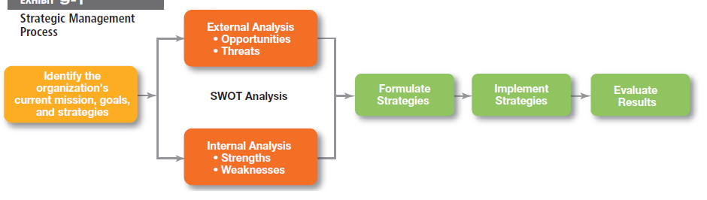
Exhibit 9-1: Strategic Management Process
Notes:
The strategic management process (see Exhibit 9-1) is a six-step process that encompasses strategy planning, implementation, and evaluation.

Slide 9
Strategic Management Process
Step 1: Identifying the organization’s current mission, goals, and strategies
Mission: a statement of the purpose of an organization
The scope of its products and services
Goals: the foundation for further planning
Measurable performance targets
Step 2: Doing an external analysis
The environmental scanning of specific and general environments
Focuses on identifying opportunities and threats

Slide 10
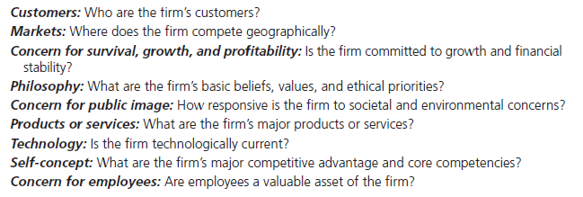
Exhibit 9-2: Components of a Mission Statement
Notes:
Mission statements provide clues to what organizations see as their purpose. What should a mission statement include? Exhibit 9-2 describes some typical components.

Slide 11
Strategic Management Process
Step 3: Doing an internal analysis
Assessing organizational resources, capabilities, and activities:
Strengths create value for the customer and strengthen the competitive position of the firm.
Weaknesses can place the firm at a competitive disadvantage.
Analyzing financial and physical assets is fairly easy, but assessing intangible assets (employee skills, culture, corporate reputation, etc.) isn’t as simple.
Steps 2 and 3 combined are called a SWOT analysis. (Strengths, Weaknesses, Opportunities, and Threats)

Slide 12
SWOT Analysis
SWOT analysis - an analysis of the organization’s strengths, weaknesses, opportunities, and threats.
Resources - an organization’s assets that are used to develop, manufacture, and deliver a product to its customers.
Capabilities - an organization’s skills and abilities in doing the work activities needed in its business.

Slide 13
Strengths and Weaknesses
Strengths - any activities the organization does well or any unique resources that it has.
Weaknesses - activities the organization does not execute well or needed resources it does not possess.
Core competencies - the organization’s major value-creating capabilities that determine its competitive weapons.

Slide 14
Strategic Management Process
Step 4: Formulating strategies
Develop and evaluate strategic alternatives.
Select appropriate strategies for all levels in the organization that provide relative advantage over competitors.
Match organizational strengths to environmental opportunities.
Correct weaknesses and guard against threats.

Slide 15
Strategic Management Process
Step 5: Implementing strategies
Implementation - effectively fitting organizational structure and activities to the environment.
The environment dictates the chosen strategy; effective strategy implementation requires an organizational structure matched to its requirements.
Step 6: Evaluating results
How effective have strategies been?
What adjustments, if any, are necessary?

Slide 16
Corporate Strategies
Corporate strategy - an organizational strategy that determines what businesses a company is in or wants to be in, and what it wants to do with those businesses.
Types of Corporate Strategies
Growth: expansion into new products and markets.
Stability: maintenance of the status quo.
Renewal: examination of organizational weaknesses that are leading to performance declines.

Slide 17
Corporate Strategies (cont.)
Growth strategy - a corporate strategy that’s used when an organization wants to expand the number of markets served or products offered, through either its current business(es) or new business(es).

Slide 18
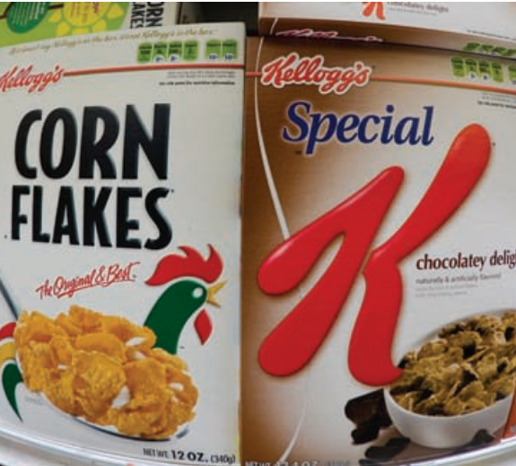
Corporate Strategies (cont.)
Stability strategy - a corporate strategy in which an organization continues to do what it is currently doing.
Renewal strategy - a corporate strategy designed to address declining performance.

Slide 19
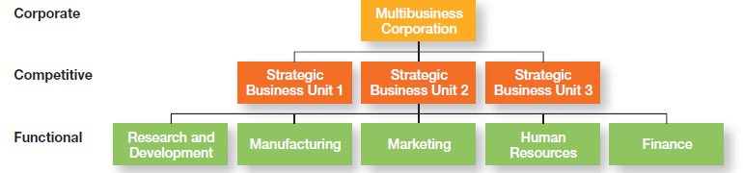
Exhibit 9-3: Types of Organizational Strategies
Notes:
As we said earlier, organizations use three types of strategies: corporate, competitive, and functional. (See Exhibit 9-3.) Top-level managers typically are responsible for corporate strategies, middle-level managers for competitive strategies, and lower-level managers for functional strategies.

Slide 20
How Are Corporate Strategies Managed?
Strategic Business Unit (SBU) - the single independent businesses of an organization that formulate their own competitive strategies.
BCG matrix - a strategy tool that guides resource allocation decisions on the basis of market share and growth rate of SBUs.

Slide 21
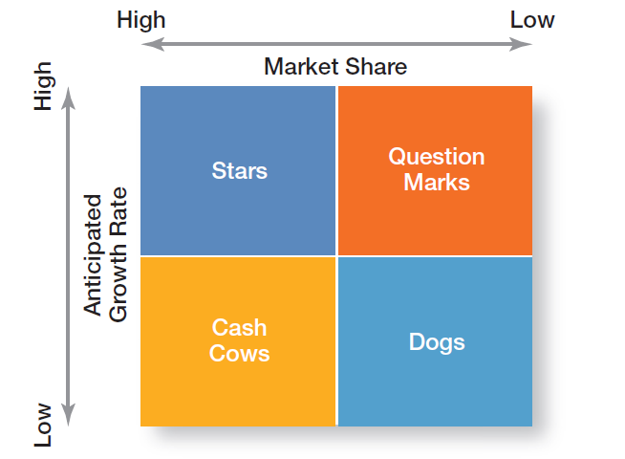
Exhibit 9-4: BCG Matrix
Notes:
The first portfolio matrix—the BCG matrix—was developed by the Boston Consulting Group and introduced the idea that an organization’s various businesses could be evaluated and plotted using a 2 * 2 matrix (see Exhibit 9-4) to identify which ones offered high potential and which were a drain on organizational resources.

Slide 22
The Role of Competitive Advantage
Competitive strategy - an organizational strategy for how an organization will compete in its business(es).
Competitive advantage - what sets an organization apart; its distinctive edge.

Slide 23

What is a Functional Strategy?
Functional strategy - the strategies used by an organization’s various functional departments to support the competitive strategy.

Slide 24
Five Competitive Forces
Threat of New Entrants
The ease or difficulty with which new competitors can enter an industry
Threat of Substitutes
The extent to which switching costs and brand loyalty affect the likelihood of customers adopting substitute products and services
Bargaining Power of Buyers
The degree to which buyers have the market strength to hold way over and influence competitors in an industry

Slide 25
Five Competitive Forces
Bargaining Power of Suppliers
The relative number of buyers to suppliers and threats from substitutes and new entrants affect the buyer-supplier relationship.
Current Rivalry
Intensity among rivals increases when industry growth rates slow, demand falls, and product prices descend.

Slide 26
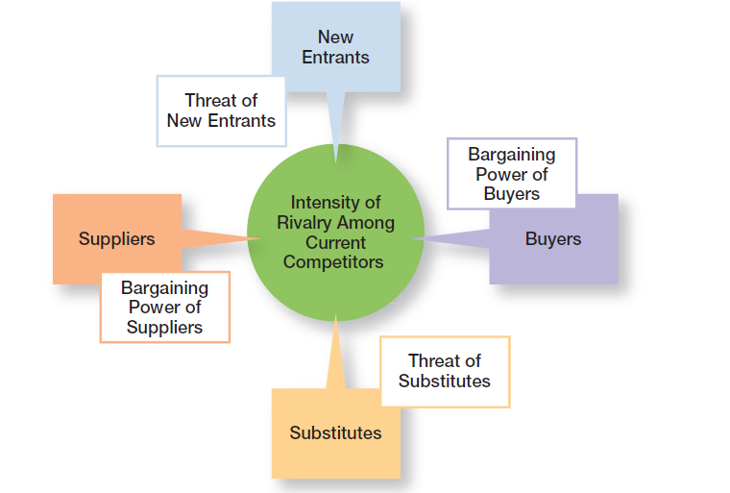
Exhibit 9-5: Five Forces Model
Notes:
In any industry, five competitive forces dictate the rules of competition. Together, these five forces (see Exhibit 9-5) determine industry attractiveness and profitability, which managers assess using these five factors.

Slide 27
The Need for Strategic Leadership
Strategic leadership - the ability to anticipate, envision, maintain flexibility, think strategically, and work with others in the organization to initiate changes that will create a viable and valuable future for the organization.

Slide 28
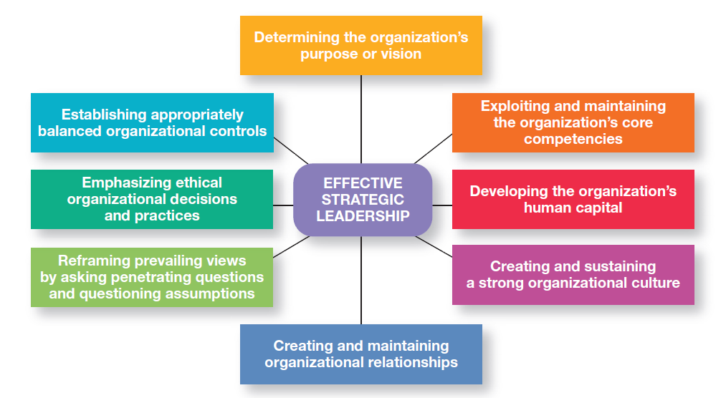
Exhibit 9-6: Effective Strategic Leadership
Notes:
How can top managers provide effective strategic leadership? Eight key dimensions have been identified.28 (See Exhibit 9-6.)

Slide 29
Types of Competitive Strategies
Cost Leadership Strategy
Seeking to attain the lowest total overall costs relative to other industry competitors
Differentiation Strategy
Attempting to create a unique and distinctive product or service for which customers will pay a premium
Focus Strategy
Using a cost or differentiation advantage to exploit a particular market segment as opposed to a larger market

Slide 30

The Need for Strategic Flexibility
Strategic flexibility - the ability to recognize major external changes, to quickly commit resources, and to recognize when a strategic decision was a mistake.

Slide 31
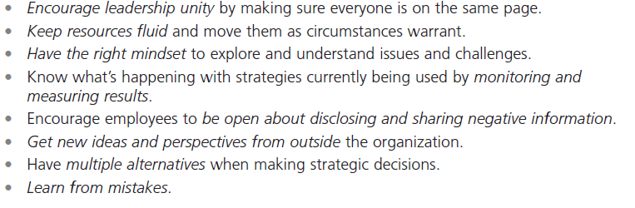
Exhibit 9-7: Developing Strategic Flexibility
Notes:
Given the highly uncertain environment that managers face today, strategic flexibility seems absolutely necessary! Exhibit 9-7 provides suggestions for developing such strategic flexibility.

Slide 32
Strategies for Applying e-Business Techniques
Cost Leadership
On-line activities: bidding, order processing, inventory control, recruitment and hiring
Differentiation
Internet-based knowledge systems, online ordering and customer support
Focus
Chat rooms and discussion boards, targeted Web sites

Slide 33
Customer Service Strategies
Giving the customers what they want
Communicating effectively with them
Providing employees with customer service training

Slide 34
Innovation Strategies
Possible Events
Radical breakthroughs in products
Application of existing technology to new uses
Strategic Decisions about Innovation
Basic research
Product development
Process innovation
First Mover - an organization that brings a product innovation to the market or uses new process innovations.

Slide 35
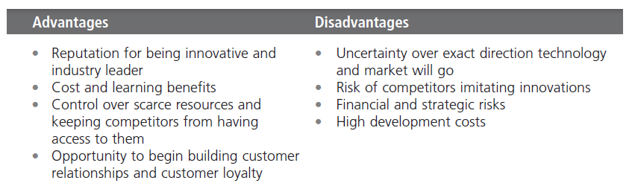
Exhibit 9-8: First-Mover Advantages and Disadvantages
Notes:
An organization that’s first to bring a product innovation to the market or to use a new process innovation is called a first mover. Being a first mover has certain strategic advantages and disadvantages as shown in Exhibit 9-8.

Slide 36
Terms to Know
strategic management
strategies
business model
strategic management process
mission
opportunities
threats
resources
capabilities
core competencies
strengths
weaknesses
SWOT analysis
corporate strategy
growth strategy
stability strategy
renewal strategy
BCG matrix
competitive strategy
strategic business units
competitive advantage
functional strategies
strategic flexibility
first mover

Slide 37
